Slide 1
Class 1
Mrs SMITH, Mrs WILTSHIRE, MISS MULHOLLAND

Slide 2
Classroom expectations
In Class 1, we aspire to be ready, safe and respectful at all times.

Slide 3
Procedure for informing the school of any issues
If you have ANY concerns, please let the class teacher know.
Even if the problem seems small, please come in and talk to us as soon as possible; it is much more difficult to unpick a situation later on.
You can catch us on the playground in the morning 08:35 – 08:45. After this time, we need to be with the children, so you may prefer to book a meeting after school.

Slide 4
Classroom Routines
Start of the day
8:35 – Adults dropping off or picking up, please do not enter the class 1 gate unless asked by a member of staff.
Children begin their day with early morning work to get them ready for their day.
Assemblies
Assemblies are in the hall as a whole school. These take place on Mondays, Wednesdays and Fridays.
Break and Lunch Times
Children go outside for break at 10:20-10:35am. Snack is provided and the children can help themselves.
Children go to lunch at 11:45am, and when they have finished eating they go outside to play until 12:55pm.
Tuesdays
Class 1 are taught by Mrs Wiltshire and Miss Mulholland.

Slide 5
PE
PE takes place on Mondays but PE can happen on any day so PE kits need to be in school everyday.
PE will be a mixture of inside and outside lessons (weather permitting) so children will need tracksuits as the weather turns cooler.
Hair needs to be tied up and all jewellery removed including earrings.

Slide 6
Reading
Children are expected to be listened to every night for 15 minutes.
Please sign their reading records so we can see that they are reading at home.
Reading books are changed regularly.
Children may have the same reading books again, this is to build on their fluency and confidence in word reading.
As children become more fluent and confident with their reading, we can start to build on their comprehension skills by asking questions about the texts/books they have read.

Slide 7
Homework
Each week there will be homework assigned on Seesaw. The homework focus will change each week based on the learning in class.
Weekly GPS will be set through assignments on Spelling Shed for Year 1.
Children need log ins for Seesaw and Spelling Shed. These will be stuck in their reading records shortly.

Slide 8
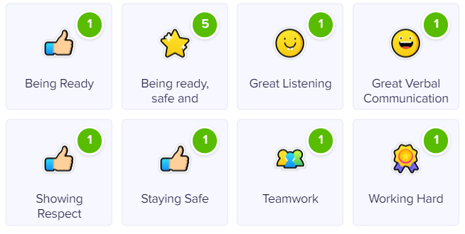
DOJO
House point reward tool.

Slide 9
Expectations
To give in letters to the teacher. We will remind them to hand in letters if they are in their bags.
To complete their homework and reading.
To always have equipment in – PE kits, book bags and water bottles.
To look after their own property. Please make sure all belongings are named. Children are encouraged to use their pegs for their jumpers etc and to pack up their PE kit themselves once it has been used. We are working VERY hard on this in Class 1!
To try for themselves, building independence. To ask their peers for support and to put their hand up when they need adult support. They’re always encouraged to have a go first but also to ask for help when it is needed. Proactive pupils is what we love to see ☺

Slide 10
Assessment
We assess different areas of learning on a daily basis. Written and photographic evidence is recorded in a learning journal and on Seesaw. Year 1’s we assess using our online Target Tracker system.
We use your child’s reading record as a form of assessment, so please do write in the comments box when you have read with your child.

Slide 11
Questions?

