Slide 1

Welcome to Class 2
Mrs Standen & Mrs Campbell

Slide 2

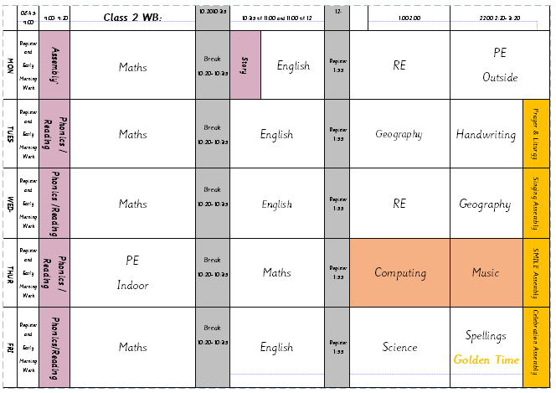
Daily Routines
Drinks/toilet breaks
Fresh air
Brain breaks
Reading
Sharing stories
Carpet Disco
PE
Monday
Thursday

Slide 3

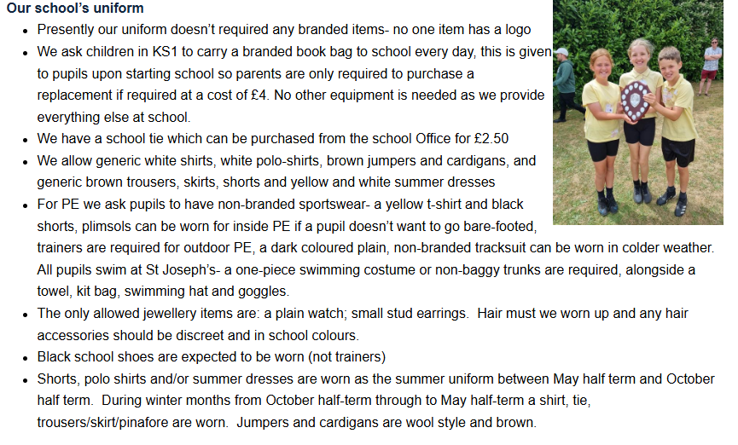

Slide 4

Reading
Please sign reading records so we can see that they are reading at home.
Reading books are changed regularly.
Children may have the same reading books again, this is to build on their fluency
and confidence in word reading.
Make reading a positive experience and celebrate their success!
As children become more fluent and confident with their reading, we can start to build
on their comprehension skills by asking questions about the texts/books they have read.

Slide 5

Phonics
Lots of information for parents on Little Wandle website.
Daily phonics lessons.
Year 2 for Autumn Term.
Reading and writing element to support learning across the curriculum.
June 2026- Phonics Screening Check- Statutory assessment for all year
ones and year twos if necessary.

Slide 6
Home Learning
Each week there will be homework assigned on Seesaw.
Year 1- Phonics & Spellings.
Year 2- Spellings and Times tables.
Additional activities will be set based on current learning,
when necessary.
*Times tables run consistently on Times Table Rockstars and are not assigned weekly.
Year 2’s to concentrate on 2, 5, 10.

Slide 7
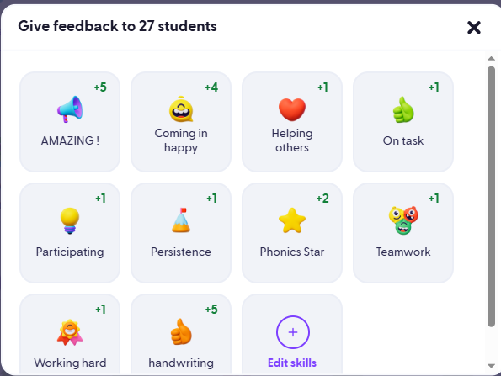

Rewards

Slide 8


