Slide 1
Welcome to Class 3
Miss Perkins, Mrs Cole, Mrs Manley and Mrs Owen

Slide 2
My Background
Graduated with QTS with PGCE in June 2023
Taught in a few local schools and have taught Reception to Year 6
Second class at St Joseph’s and loving it!

Slide 3
Procedure for informing the school of any issues
If you have any concerns, please let the class teacher know
Even if the problem seems small, please come in and talk to us.
Alternatively, please message on seesaw or arrange a meeting!
Children can speak to us and use the worry box

Slide 4
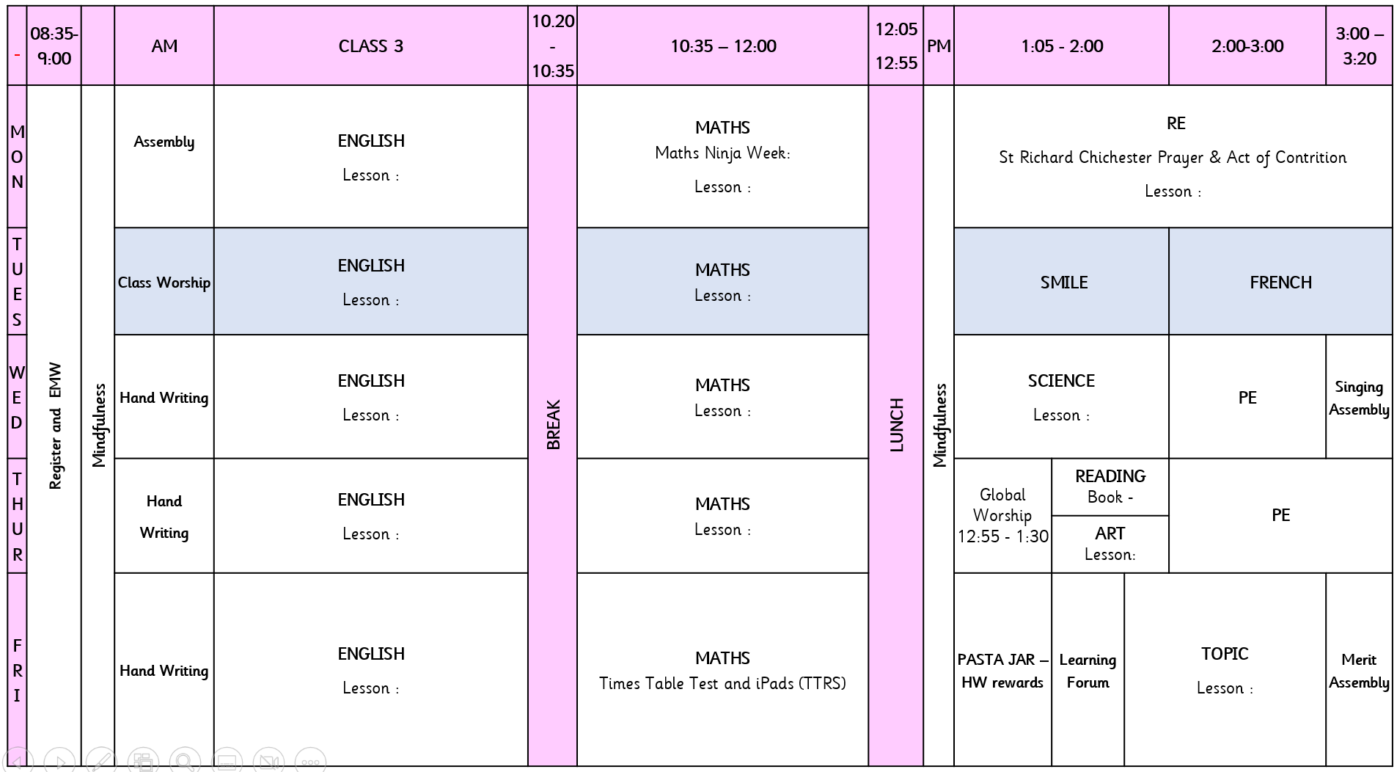
Classroom Routines Expectations and Timetable
We try to encourage the children to be as independent and resilient as possible when they move into class 3.
We expect them to get out their reading record, book, early morning workbook and whiteboard for the day
To complete their homework and reading.
To always have equipment in – PE kits, book bags and water bottles.
PE – Wednesdays and Thursdays
Snacks need to be brought in for break times
Class 3 is taught by Mrs Dixon and Mrs Cole

Slide 5
Homework
Each week, the children have two tasks to do
English : Reading at least 4 times a week – children can sign their own diary or you can!
Maths: TTRS as much as possible. This contributes to our pasta reward system but also individual rewards for those children who go above and beyond.
Occasionally can be extras or offer of extra homework for consolidation and understanding
Children have their log ins for Seesaw in their reading records. Please ensure that you log on and access your child’s Seesaw account. Important messages and homework will be uploaded on here.

Slide 6
Rewards
Stickers
Secret Student
Messages on Seesaw
Pasta reward jar.

Slide 7
Assessment
We assess the children throughout the year. They always have a hot and cold task in English and Maths.
In Class 3, we focus heavily on Timestables! These are extremely important, especially for the Year 4s. They have a test every Friday!
The government have put in place the MTC for Year 4 pupils to complete 25 questions, 6 seconds each, any times table up to 12 x 12. This happens in June
Practise of TTRS is essential for the progress and learning of time tables.

Slide 8
TTRS
Jamming – Easy, not timed. I suggest choosing just multiplication and maybe 20 questions. This lets the children choose the times tables that they want to focus on.
Gig – once a month and it is there to try and beat their own record
Garage – Easy, is timed, get all of the times tables, mixture of multiplication and division
Soundcheck – is a copy of the MTC the Year 4s have to do at the end of the year. Really helpful for practice, will do this 4 times on a Friday in class for practise.
Would recommend Jamming and Soundcheck mode, mostly
Notes:
SAMPLE
SAM

Slide 9
Questions?

