Slide 1
Class 1
Mrs SMITH, Mrs WILTSHIRE, Mrs Campbell

Slide 2
Classroom expectations
In Class 1, we aspire to be ready, safe and respectful at all times.

Slide 3
Procedure for informing the school of any issues
If you have ANY concerns, please let the class teachers know.
Even if the problem seems small, please come in and talk to us as soon as possible; it is much more difficult to unpick a situation later on.
You can catch us on the playground in the morning 08:35 – 08:45. After this time, we need to be with the children, so you may prefer to book a meeting after school.

Slide 4
Classroom Routines
Start of the day
8:35 – Adults dropping off or picking up, please do not enter the class 1 gate unless asked by a member of staff.
Children begin their day with early morning work to get them ready for their day.
Assemblies
Assemblies are in the hall as a whole school. Assemblies take place on Mondays, Wednesdays, Thursdays and Fridays. Class collective worship is on Tuesdays.
Break and Lunch Times
Children have their break time from 10:20-10:35am. Snack is provided and we eat this together.
Children go to lunch at 11:45am, and when they have finished eating they go outside to play until 12:55pm.
Our lunch menu is in the weekly newsletter. Please check this each week.
Mondays, Tuesdays, Wednesday mornings
Mrs Smith is the class teacher, supported by Mrs Wiltshire.
Wednesday afternoons, Thursdays & Fridays
Mrs Wiltshire is the class teacher, supported by Mrs Campbell or Mrs Cole.

Slide 5
PE
PE takes place on Tuesdays. Children should come to school in their PE kits.
PE will be a mixture of inside and outside lessons (weather permitting) so children will need tracksuits as the weather turns cooler.
Hair needs to be tied up and all jewellery removed including earrings.

Slide 6
Reading
We follow a scheme called Little Wandle to support the children with reading.
Phonics is taught daily.
We will upload the graphemes that the reception children are learning each week to Seesaw so that you can practise them at home. There should be around 4 graphemes per week.
Your child’s reading book will match their phonetic knowledge and as they learn more graphemes, their reading books will reflect this learning.
Reading books may appear ‘easy’ but this is what we want. We want children to be reading at 90% fluency to maintain their reading confidence.
Please sign your child’s reading records so that we can see that they are reading at home.
Reading books are changed weekly.
Children may have the same reading books again, this is to build on their fluency and confidence in word reading.
As children become more fluent and confident with their reading, we can start to build on their comprehension skills by asking questions about the texts/books they have read.

Slide 7
Homework
Each week there will be homework assigned on Seesaw. The homework focus will change each week based on the learning in class.
The Year 1 children will receive weekly spellings. They will be assigned on Seesaw and are taken from Little Wandle so they match the current learning.
Children have their log ins for Seesaw. Please ensure that you log on and access your child’s Seesaw account. Important messages and homework will be uploaded on here.

Slide 8
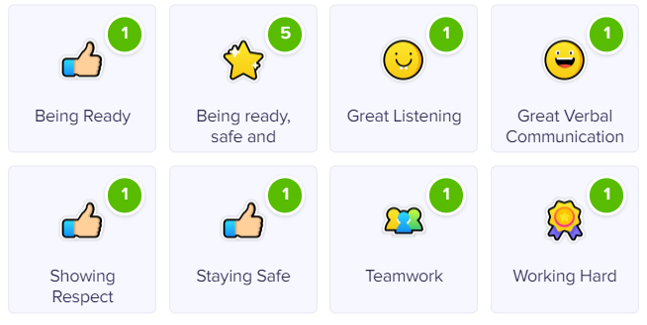
DOJO
House point reward tool.

Slide 9
Expectations
To give in letters to the teacher. We will remind them to hand in letters if they are in their bags.
To complete their homework and reading.
To always have equipment in – book bags and water bottles.
To look after their own property. Please make sure all belongings are named. Children are encouraged to use their pegs for their jumpers etc. We are working VERY hard on this in Class 1!
To apply sun cream in the morning and provide a bottle of sun cream in your child’s book bag when needed so that they can reapply before lunch.
To try for themselves, building independence. To ask their peers for support and to put their hand up when they need adult support. They’re always encouraged to have a go first but also to ask for help when it is needed. Proactive pupils is what we love to see ☺

Slide 10
Assessment
We assess different areas of learning on a daily basis. Written and photographic evidence is recorded in a learning journal and on Seesaw. We use our online system for the Year 1 children.
We use your child’s reading record as a form of assessment, so please do write in the comments box when you have read with your child.

Slide 11
Questions?

